Slide 1
KYTC Partnering Conference • Louisville, August 16, 2017
Notes:
Welcome and intro

Slide 2

Quantitative Safety Alternatives analysis
Derek Troyer
August 16, 2016

Slide 3
Ohio Crash Trends

Slide 4
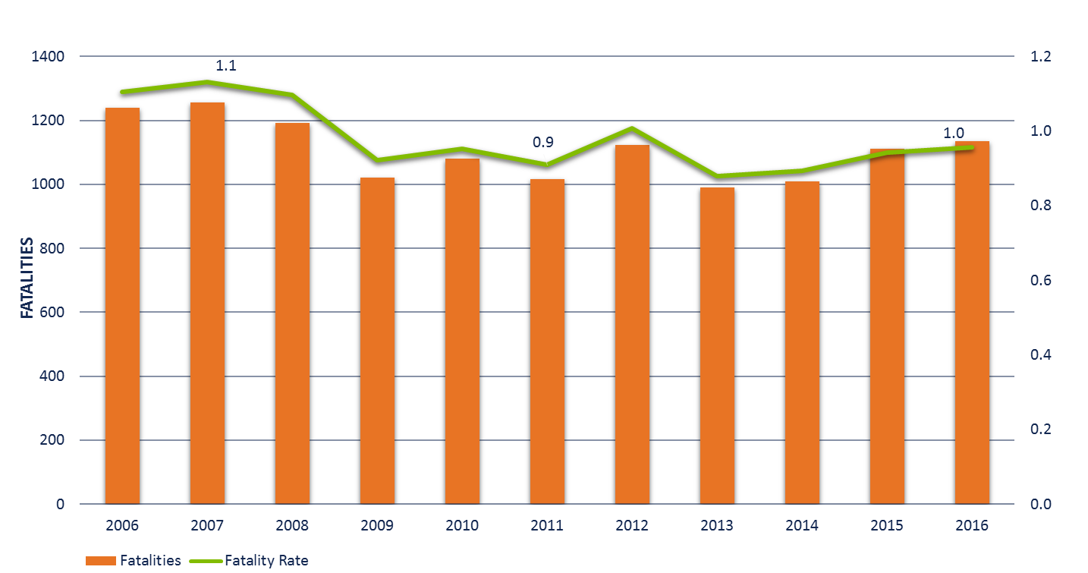
Historical Crash Trends
Notes:
Because our transportation network is so large, we tend to get a lot of crashes. Last year in Ohio, we had 1,134 traffic deaths, over 9,000 serious injuries and over 300,000 crashes.
The home rule environment, large number of crashes and the overall size of our annual funding program make integrating safety into all project planning an enormous challenge … and incredible opportunity.

Slide 5
Historical Crash Trends
Fatalities by Strategic Highway Safety Plan Emphasis Area
50%
570 Total
34%
389 Total
32%
350 Total
ROADWAY DEPARTURE
SPEED
SEAT BELT
31%
346 Total
30%
339 Total
*Based on 2016 Crash Data
ALCOHOL
YOUNG DRIVER

Slide 6
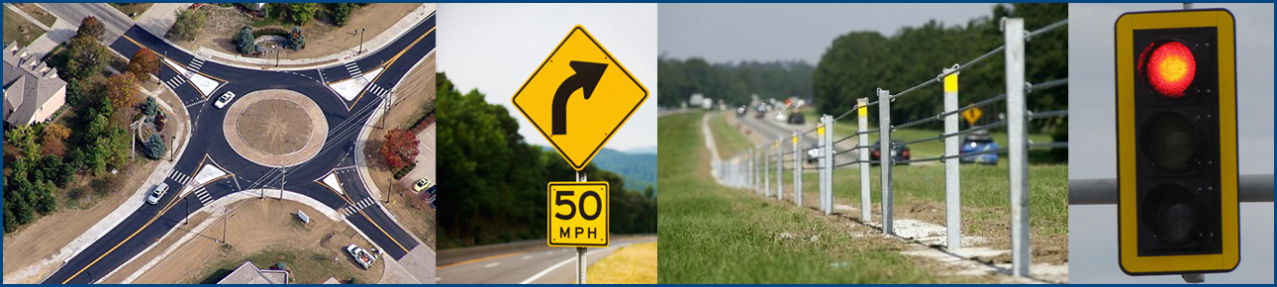
Ohio Spot Safety Program
ODOT has one of the largest programs in the country.
  $102M annually
  Any public road
  200+ projects
  Accept applications 2X per year
  Up to $10M

Slide 7
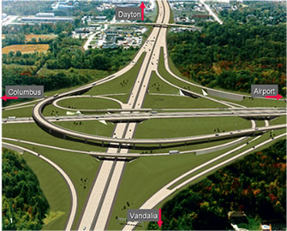


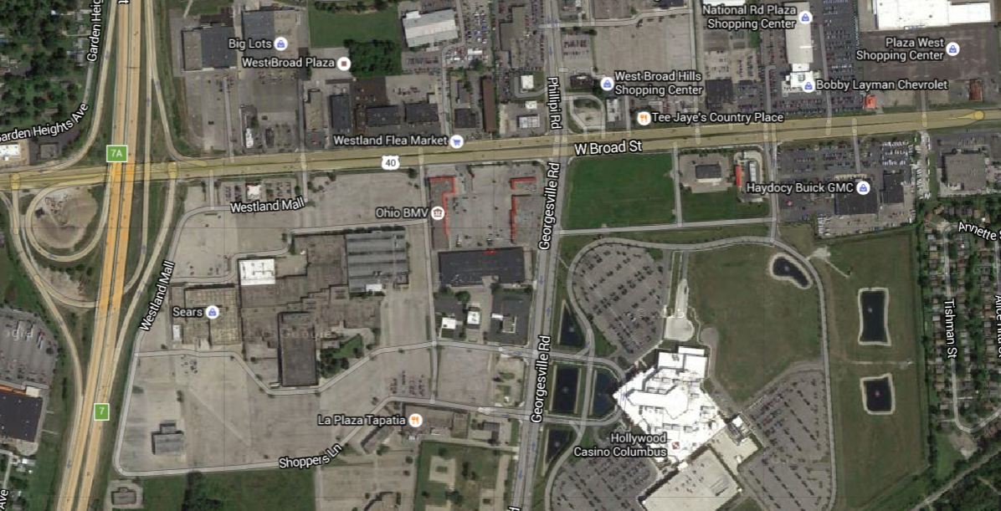
Ohio Spot Safety Program

Slide 8
System-wide Treatments
ODOT sets aside about $15M for low-cost treatments that can be implemented across hundreds of miles for thousands of dollars.
  Upgrade signs on curves
  Install reflectorized back plates at intersections
  Install edge line rumble stripes

Slide 9
Questions

Slide 10
Highway safety manual
(In 10 minutes or less)

Slide 11
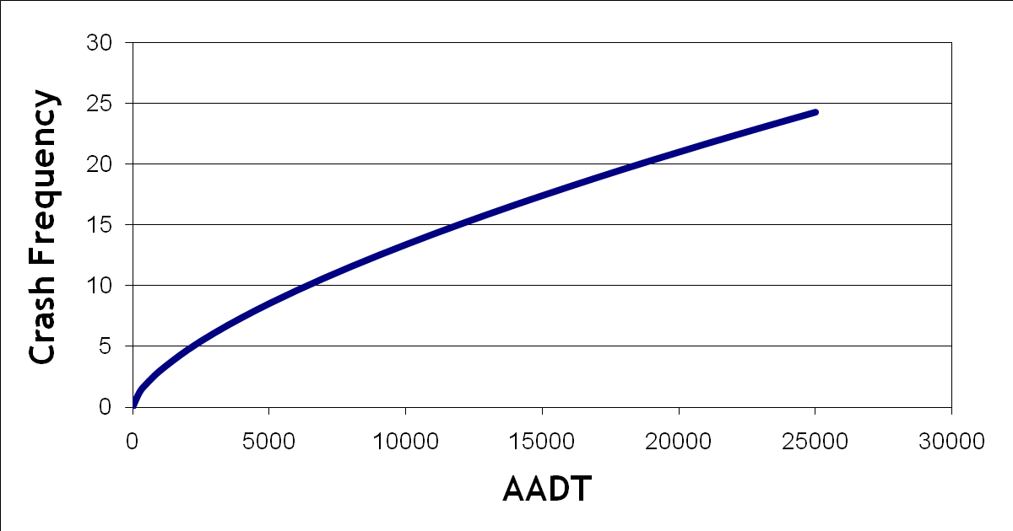
Safety Performance function
Observed / Historical Crashes
Potential for Safety Improvement
Expected Crashes
Predicted
Crashes
Notes:
It is very common to select a location based on a short term ‘spike’ in crashes; and to measure the effect of a treatment based on what happens immediately following the implementation of a solution. The actual effect of the solution should be measured based on the long term average.

Slide 12
Highway safety manual
Site is expected to have more crashes per year on average than its peers
→ Potential for improvement!
Expected average crash frequency for the site
Difference = Expected Excess Crashes (Potential for Safety Improvement)
Crashes
Predicted Average Crash Frequency for the site (how are its peers performing on average?)
Expected average crash frequency for the site
Site is expected to fewer more crashes per year on average than its peers
Years
Notes:
Mathematical expression used to estimate the predicted average crash frequency for a base condition
Product of a statistical modeling process

Slide 13
Highway Safety Manual
Site selected for treatment due to short term trend
Perceived effectiveness
of treatment
Observed Crash Frequency
Actual effectiveness
of treatment
Expected Average Crash Frequency (without treatment)
Observed Average Crash Frequency (after treatment)
Years
Notes:
It is very common to select a location based on a short term ‘spike’ in crashes; and to measure the effect of a treatment based on what happens immediately following the implementation of a solution. The actual effect of the solution should be measured based on the long term average.

Slide 14
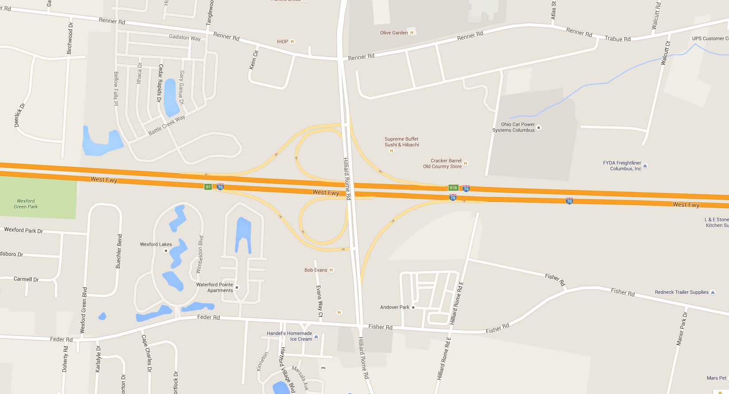


Available Site Types
Urban Segment
Divided Segment
Rural Segment
Signalized Intersections
Ramps
Ramp Terminal Intersections
Freeway Segment
Stop Controlled Intersections

Slide 15
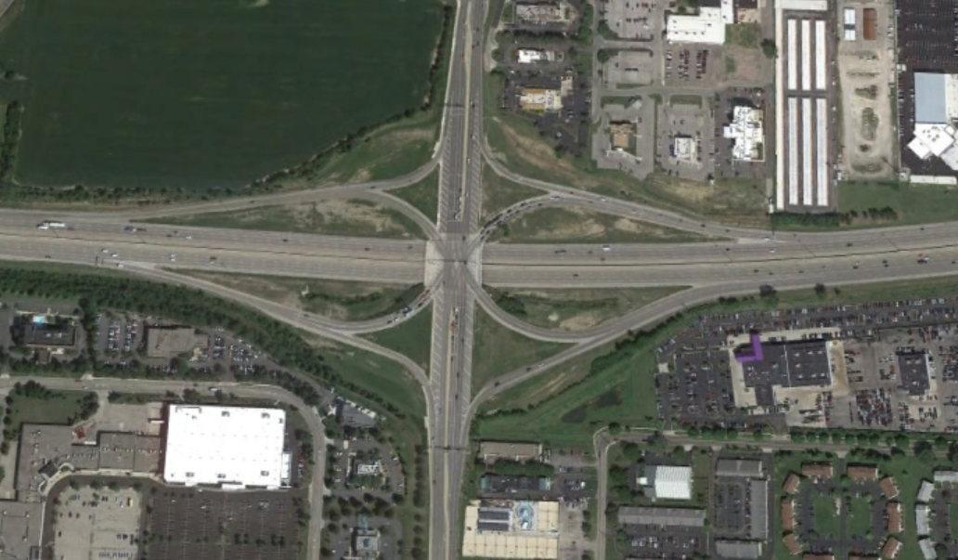
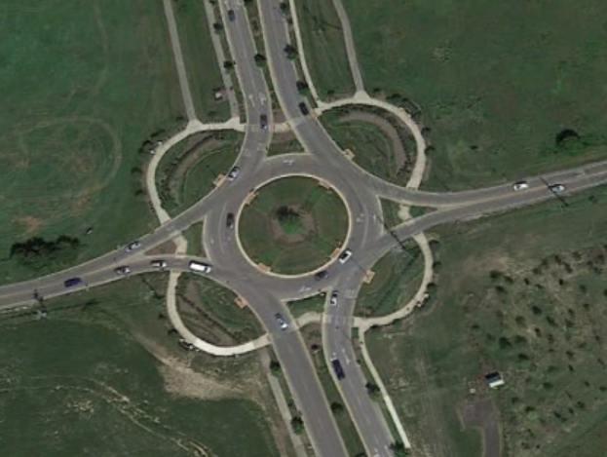
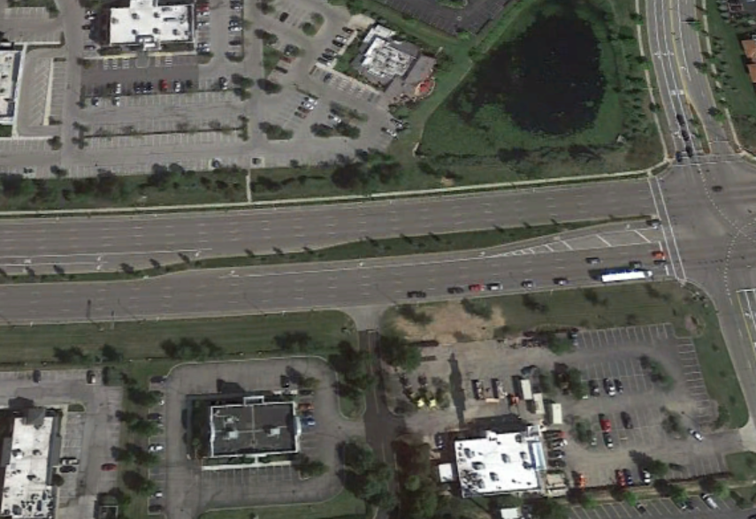
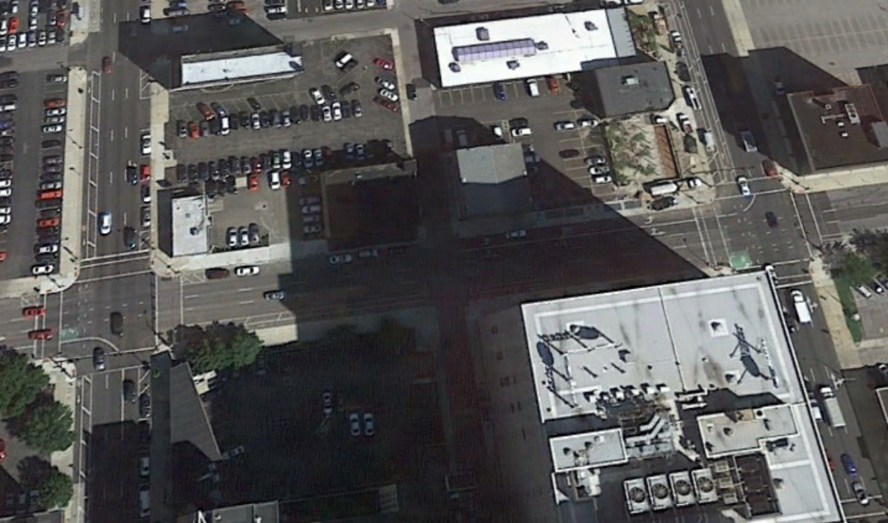
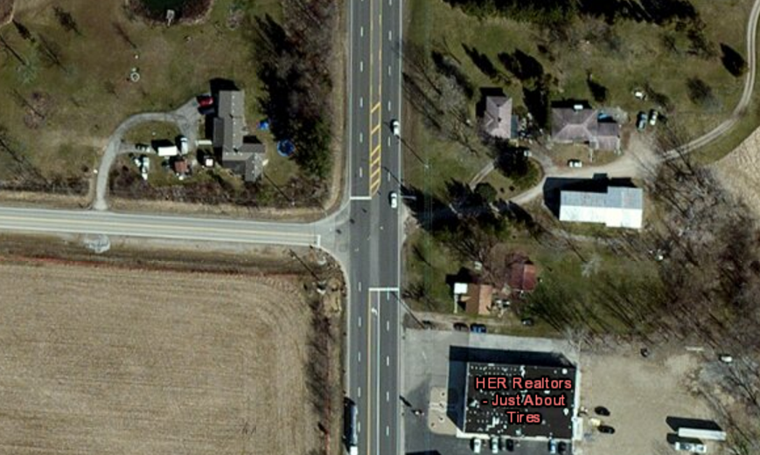
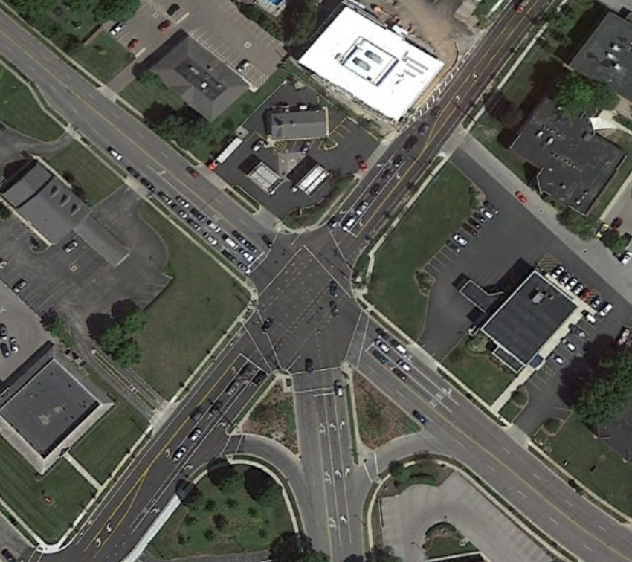
Additional site types under development

Slide 16
Safety Analysis procedure
Analyze Every Segment & Intersection
Sum Crashes Across All Segments & Intersections
Repeat for Each Alternative
Evaluate All Design Alternatives
Notes:
Key Message:
Apply the project level EB Method if observed crash data are available and the crash data are not able to be accurately assigned to specific sites. This method will still enhance your predicted crash estimate.
Background:
Repeat the basic steps plus the site-specific EB analysis (when applicable) for the next study site. Continue evaluating additional sites and time periods until all sites and time periods have been completed.
The total estimated number of crashes for the facility network during the study period is calculated using the equation:
N _{(total)} = ∑N_{(all rs)} + ∑N_{(all int)}
Where:
N _{(total)} = total expected number of crashes within the roadway limits of the study for all years in the period of interest. Or, the sum of the expected average crash frequency for each year for each site within the defined roadway limits within the study period;
N _{(rs)} = expected average crash frequency for a roadway segment using the predictive method for one year;
N _{(int)} = expected average crash frequency for an intersection using the predictive method for one year.
Repeat the process if an alternate design is to be evaluated. This generally involves modifying CMFs for the various design configurations. Since the predictive method is used to estimate the expected average crash frequency of a site, network, or facility, the expected crashes for alternative designs can then be compared to aid with the decision process.
Acronyms: CMF = Crash Modification Factor (or Function), EB = Empirical Bayes
Interactivity: N/A
Notes: N/A

Slide 17
On-going research
NCHRP 17-56
  Development of Crash Modification Factors for Uncontrolled Pedestrian Crossing Treatments
NCHRP 17-59
  Safety Impacts of Intersection Sight Distance
NCHRP 17-58
  Safety Prediction Models for Six-Lane and One-Way Urban and Suburban Arterials
NCHRP 17-62
  Improved Prediction Models for Crash Types and Crash Severities
NCHRP 17-63
  Guidance for the Development and Application of Crash Modification Factors
NCHRP 17-68
  Intersection Crash Prediction Methods for the Highway Safety Manual
NCHRP 17-70
  Development of Roundabout Crash Prediction Models and Methods
NCHRP 17-71
  Proposed AASHTO Highway Safety Manual, Second Edition
NCHRP 17-72
  Update of Crash Modification Factors for the Highway Safety Manual
Notes:
Highlight:
Proposed AASHTO Highway Safety Manual, Second Edition
Safety Prediction Models for Six-Lane and One-Way Urban and Suburban Arterials
Intersection Crash Prediction Methods for the Highway Safety Manual

Slide 18
Questions

Slide 19
Where to begin

Slide 20
Highway safety improvement program application
Ohio started by modifying the Safety Funding Program
  The priority list methodology
  Estimation of safety benefits of proposed projects

Slide 21

Safety priority list
Used for 2010 HSIP
Priority List
Focused on network screening
Also includes:
  Diagnosis and Countermeasure Selection
  Economic Appraisal
  Countermeasure Evaluation
Fully implements Part B of the HSM

Slide 22
Safety Analyst
Crash Data
Road Inventory
Traffic Volumes
Project History
Data Requirements

Slide 23
Estimating safety benefits
HSM Part C for site analysis
Need tools to complete analysis
  NCHRP 17-38 Spreadsheets
  Enhanced Interchange Safety Analysis Tool (ISATe) – NCHRP 17-45
  Interactive Highway Safety Design Model (IHSDM) -FHWA
  Ohio: Economic Crash Analysis Tool (ECAT)

Slide 24
Questions

Slide 25
Quantitative does not mean complicated

Slide 26
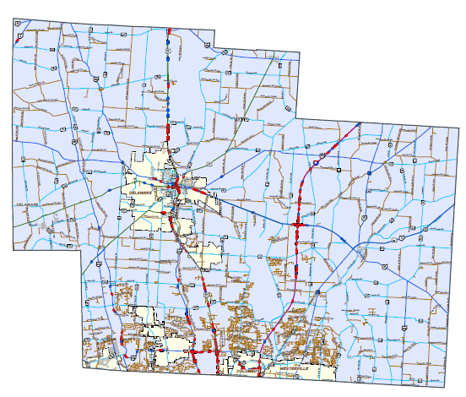
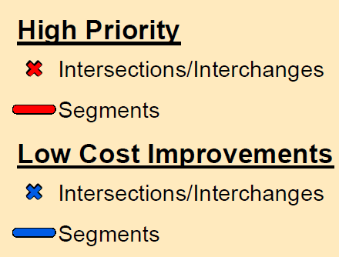

Safety for all projects
Safety Integrated Project (SIP) Maps
  Identifies Priority Safety Locations with a potential to reduce crashes
DELAWARE COUNTY
Notes:
Ohio created SIP maps for each of Ohio’s 88 counties. The maps
These maps identify Priority Safety Locations, using Safety Analyst, where safety improvements should be considered. So when a district programs a project, we’re asking our staff to review these maps to see if the project overlaps one or more of these areas.
Locations are prioritized in red and blue. Red has a high priority ( and the potential to reduce 5 or more crashes per year). These areas may qualify for Safety funding. Blue has a lower priority (potential to reduce 3-5 crashes per year). Districts are encouraged to explore low-cost safety improvements with their own forces and funds.

Slide 27
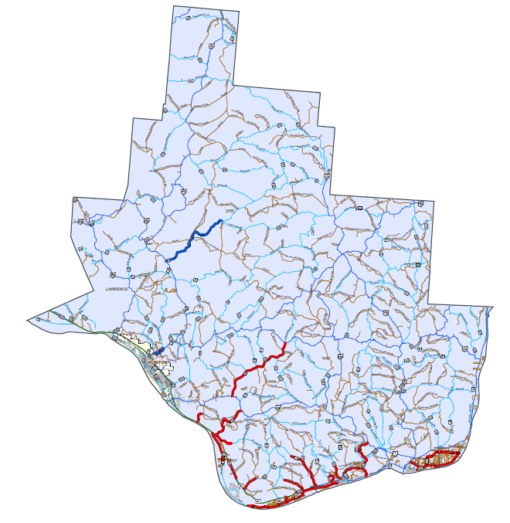
Step 1: review SIP Map
Does the project overlap a safety location?
ADAMS COUNTY

Slide 28
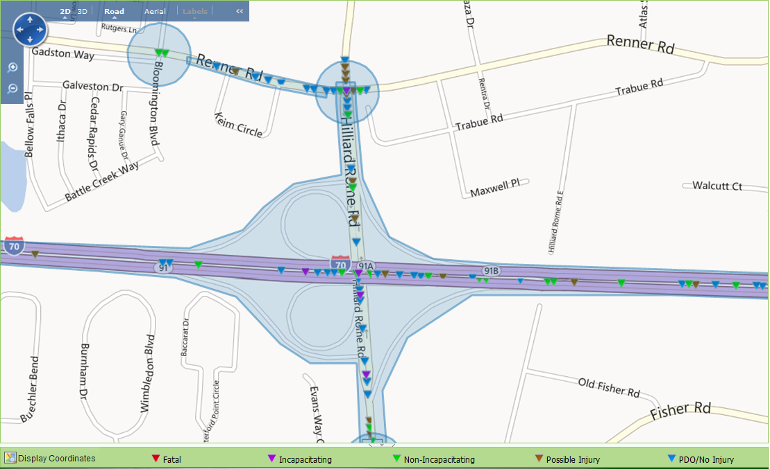

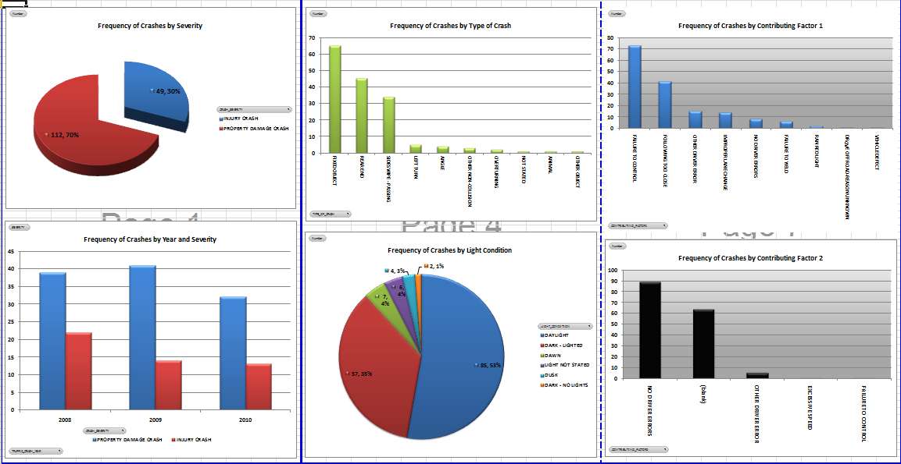
Step 2: Crash Analysis
Review crash data

Slide 29
Step 3: Identify Countermeasures
Blue: District investigates low-cost improvements
Red: Improvements may be eligible for HSIP funds
ADAMS COUNTY

Slide 30
Safety Integrated Project Maps
Integrates safety analysis into all projects
Adds safety analysis to scope
Provides HSIP Funds
Abbreviated process to expedite review

Slide 31
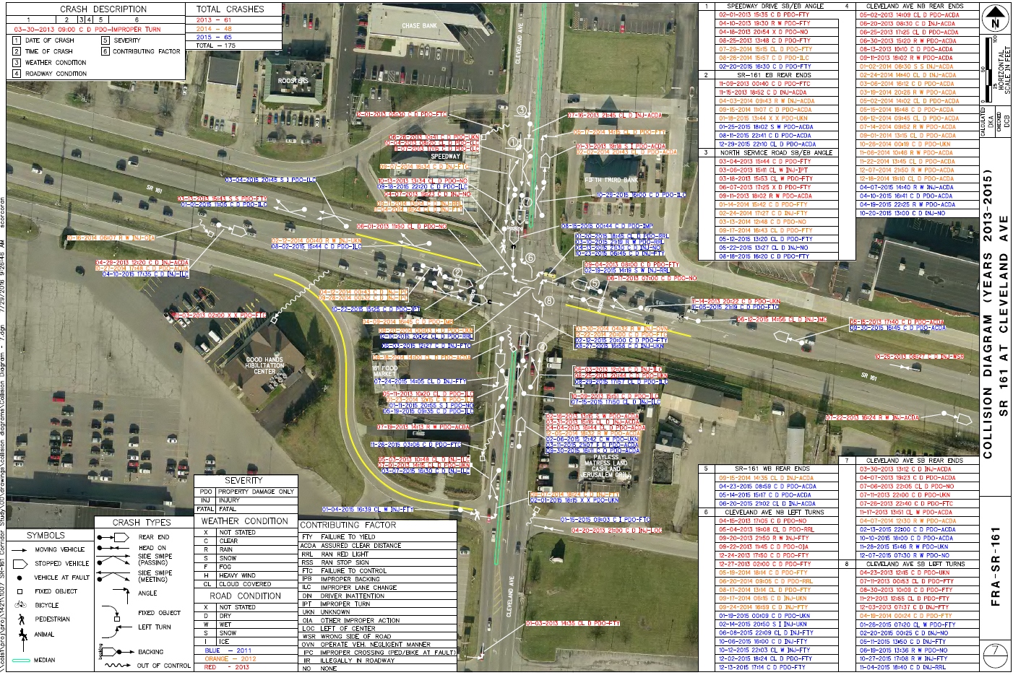
SIP Map - Example
Notes:
​​
There were a total of 175 reported crashes that occurred at this intersection of State Route 161 and Cleveland Avenue between 2013 and 2015.
30% (53) resulted in injury
20% (35) Angle crashes.
12% (21) crashes occurred with a vehicle exiting a driveway on the north leg of the intersection from the east headed south.

Slide 32
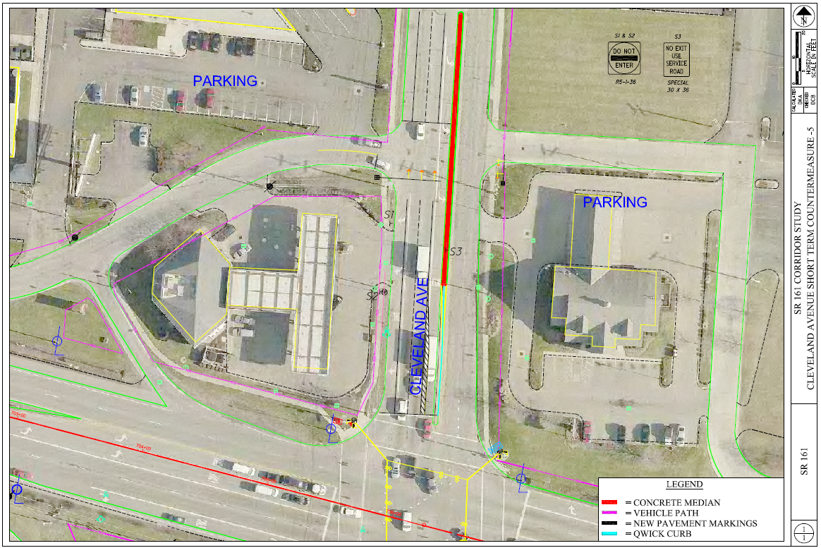
SIP Map - Example
Notes:
Project aligns left turn lanes.
Lengthens median barrier to prevent left turn movements from access driveways and providing additional left turn storage.
Supplemental signals will provide access roadway controlled access to Cleveland Ave.

Slide 33
SIP Map - Example
$340,000
No right of way required
Includes access management

Slide 34
Questions

Slide 35
Justifying Design Exceptions

Slide 36
Roadway Engineering / geometrics
Ohio’s safety program has a strong relationship with designers
Performance based practical design
  OH: Performance based project development

Slide 37
Roadway Engineering / geometrics
Demonstrating the power of the HSM
Interstate 90 Westbound
  3 to 4 lanes
  11 foot minimum lane width

Slide 38
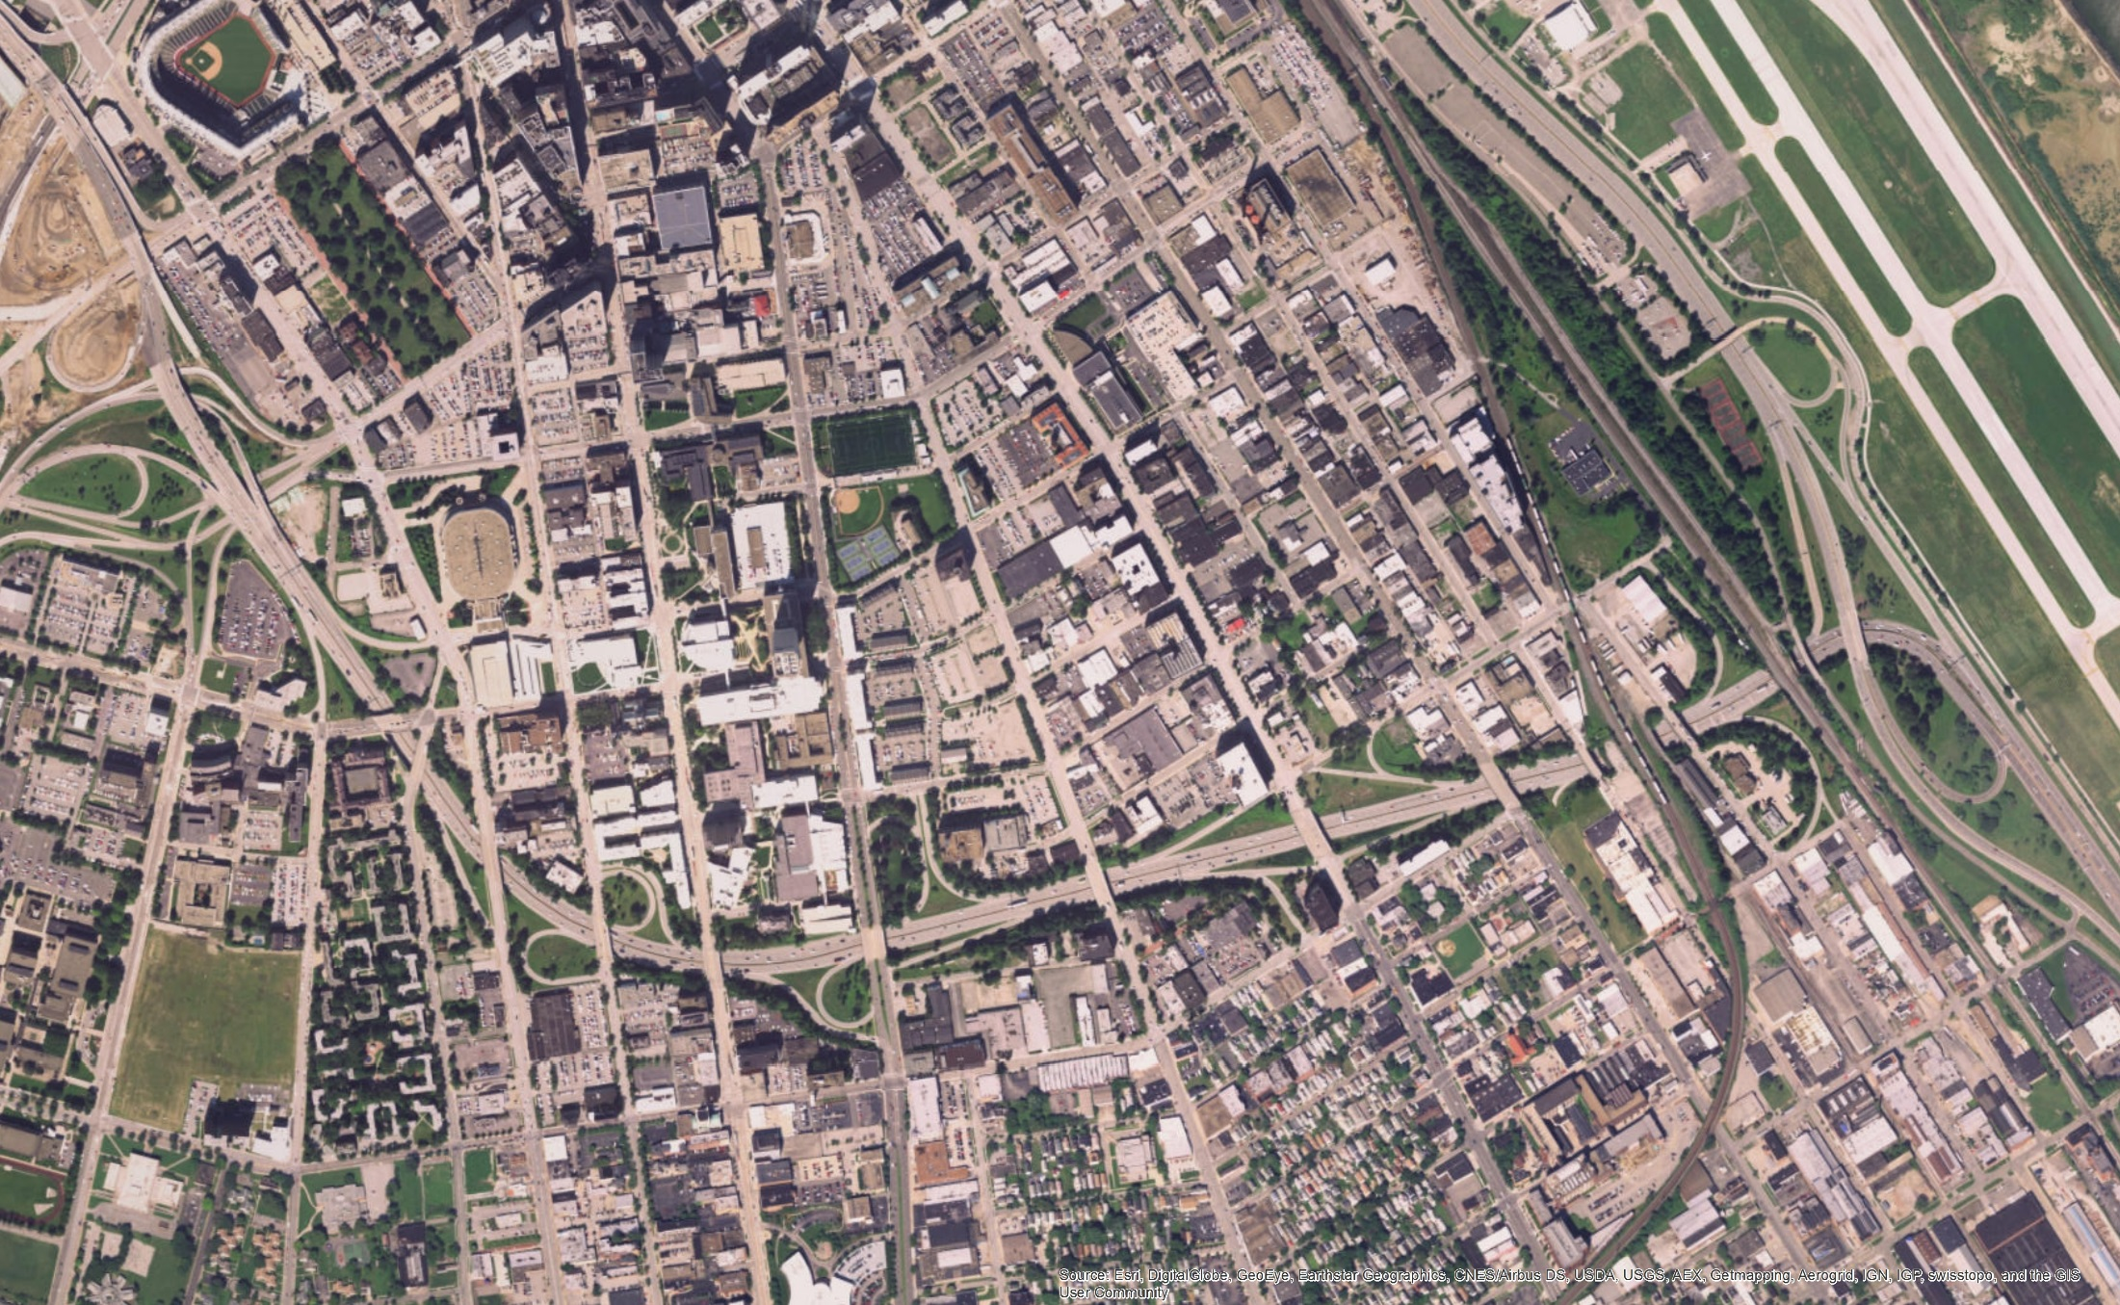
Interstate 90 Westbound
Notes:
Add one lane “Westbound” on I-90 in downtown Cleveland
10 overhead structures
Survey grade measurements to confirm space between piers.

Slide 39
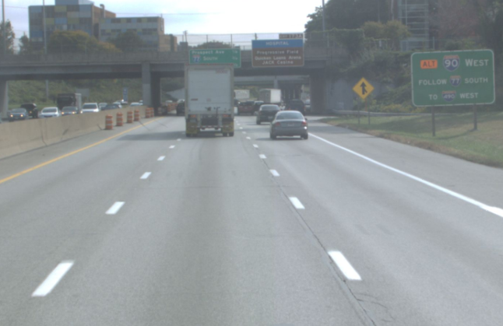
Interstate 90 Westbound

Slide 40
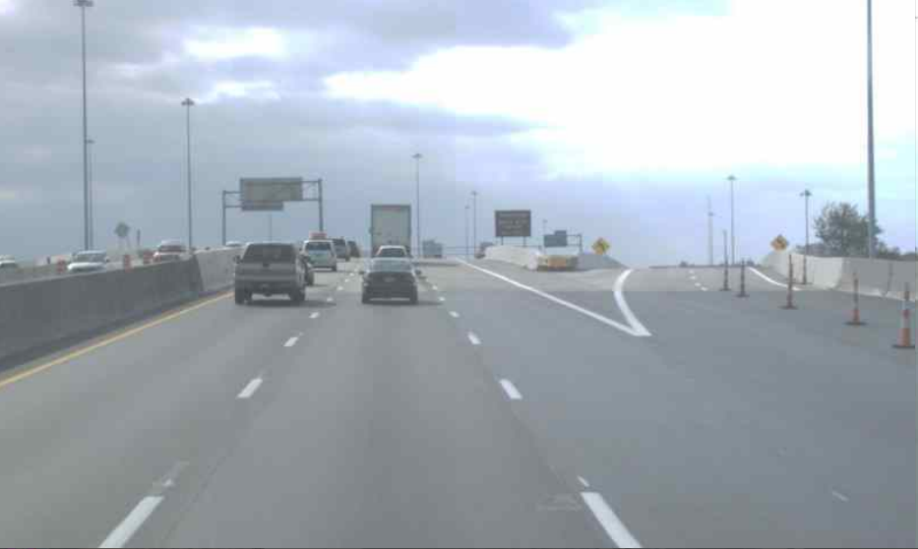
Interstate 90 Westbound

Slide 41
Interstate 90 Westbound
Comparison based on crash frequency
With additional safety countermeasures:

Slide 42
Interstate 90 Westbound
Comparison based on crash severity weighting
With additional safety countermeasures:

Slide 43
Questions

Slide 44
Moving forward

Slide 45
Safety analysis & Feasibility study
Divided into three categories
  Non-complex projects
  Complex projects without safety in purpose and need statement
  Complex projects with safety in the purpose and need statement
Notes:
This is very specific to Ohio. It requires SPFs and / or Calibration factors.
Historical crash data.

Slide 46
Safety analysis & Feasibility study
Non-complex projects
  Check the SIP map and the HSIP Priority Location List
  Review historical crash trends
Does a crash pattern exist?
Can a countermeasure be included in the current project?

Slide 47
Safety analysis & Feasibility study
Complex projects
  WITHOUT safety in purpose and need statement
  Compare change in predicted crashes between alternatives
  Compare with enviro, ROW, Operation…
Does a crash pattern exist?
Can a countermeasure be included in the current project?

Slide 48
Safety analysis & Feasibility study
Complex projects
  WITH safety in purpose and need statement
  Estimate the expected performance of the existing conditions
  Estimate crash frequencies for the major project components
  Add safety countermeasures to reduce crash frequency, if necessary.

Slide 49
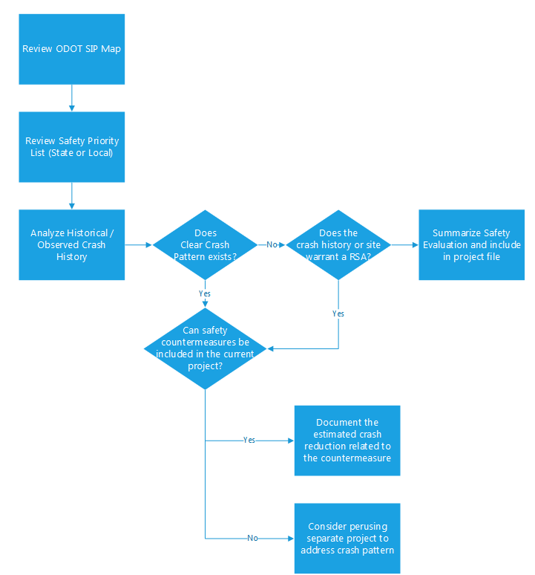
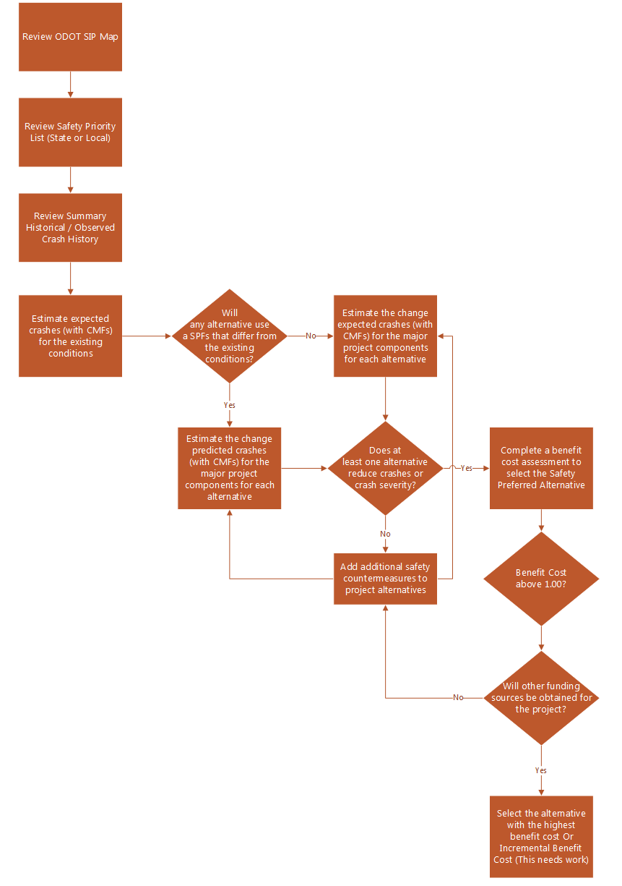
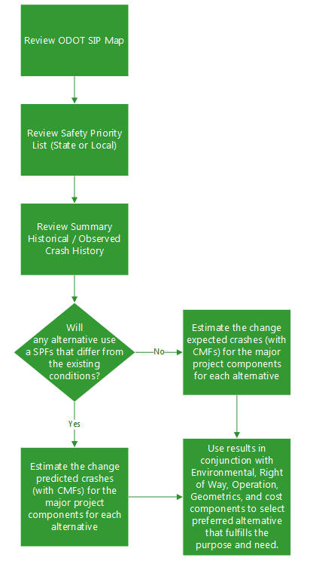
Safety analysis & Feasibility study
Non Complex
Complex
Without Safety
Complex
With Safety

Slide 50
?
Derek Troyer, PE
Ohio DOT
614.387.5164
Derek.Troyer@dot.ohio.gov

